Slide 1
Chapter 8
I/O

Slide 2
I/O: Connecting to Outside World
So far, we’ve learned how to:
  compute with values in registers
  load data from memory to registers
  store data from registers to memory
But where does data in memory come from?
And how does data get out of the system so that
humans can use it?

Slide 3
I/O: Connecting to the Outside World
Types of I/O devices characterized by:
  behavior: input, output, storage
    input: keyboard, motion detector, network interface
    output: monitor, printer, network interface
    storage: disk, CD-ROM
  data rate: how fast can data be transferred?
    keyboard: 100 bytes/sec
    disk: 30 MB/s
    network: 1 Mb/s - 1 Gb/s

Slide 4
I/O Controller
Control/Status Registers
  CPU tells device what to do -- write to control register
  CPU checks whether task is done -- read status register
Data Registers
  CPU transfers data to/from device
Device electronics
  performs actual operation
    pixels to screen, bits to/from disk, characters from keyboard
Graphics Controller
Control/Status
CPU
Electronics
display
Output Data

Slide 5
Programming Interface
How are device registers identified?
  Memory-mapped vs. special instructions
How is timing of transfer managed?
  Asynchronous vs. synchronous
Who controls transfer?
  CPU (polling) vs. device (interrupts)

Slide 6
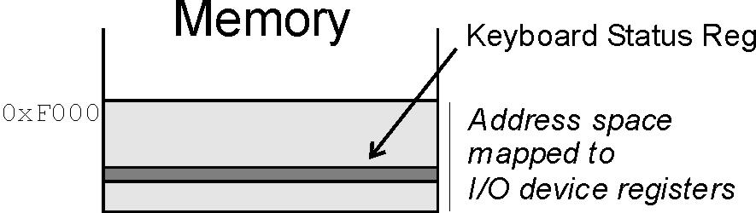
Memory-Mapped vs. I/O Instructions
Instructions
  designate opcode(s) for I/O
  register and operation encoded in instruction
Memory-mapped
  assign a memory address
  to each device register
  use data movement
  instructions (LD/ST)
  for control and data transfer

Slide 7
Transfer Timing
I/O events generally happen much slower
than CPU cycles.
Synchronous
  data supplied at a fixed, predictable rate
  CPU reads/writes every X cycles
Asynchronous
  data rate less predictable
  CPU must synchronize with device,
  so that it doesn’t miss data or write too quickly

Slide 8
Transfer Control
Who determines when the next data transfer occurs?
Polling
  CPU keeps checking status register until
  new data arrives OR device ready for next data
  “Are we there yet? Are we there yet? Are we there yet?”
Interrupts
  Device sends a special signal to CPU when
  new data arrives OR device ready for next data
  CPU can be performing other tasks instead of polling device.
  “Wake me when we get there.”

Slide 9
LC-3
Memory-mapped I/O (Table A.3)
Asynchronous devices
  synchronized through status registers
Polling and Interrupts
  the details of interrupts will be discussed in Chapter 10
Location | I/O Register | Function
xFE00 | Keyboard Status Reg (KBSR) | Bit [15] is one when keyboard has received a new character.
xFE02 | Keyboard Data Reg (KBDR) | Bits [7:0] contain the last character typed on keyboard.
xFE04 | Display Status Register (DSR) | Bit [15] is one when device ready to display another char on screen.
xFE06 | Display Data Register (DDR) | Character written to bits [7:0] will be displayed on screen.

Slide 10
Input from Keyboard
When a character is typed:
  its ASCII code is placed in bits [7:0] of KBDR
  (bits [15:8] are always zero)
  the “ready bit” (KBSR[15]) is set to one
  keyboard is disabled -- any typed characters will be ignored
When KBDR is read:
  KBSR[15] is set to zero
  keyboard is enabled
keyboard data
15
8
7
0
KBDR
15
14
0
ready bit
KBSR

Slide 11
Basic Input Routine
POLL LDI R0, KBSRPtr
BRzp POLL
LDI R0, KBDRPtr
...
KBSRPtr .FILL xFE00
KBDRPtr .FILL xFE02
new
char?
NO
Polling
YES
read
character

Slide 12
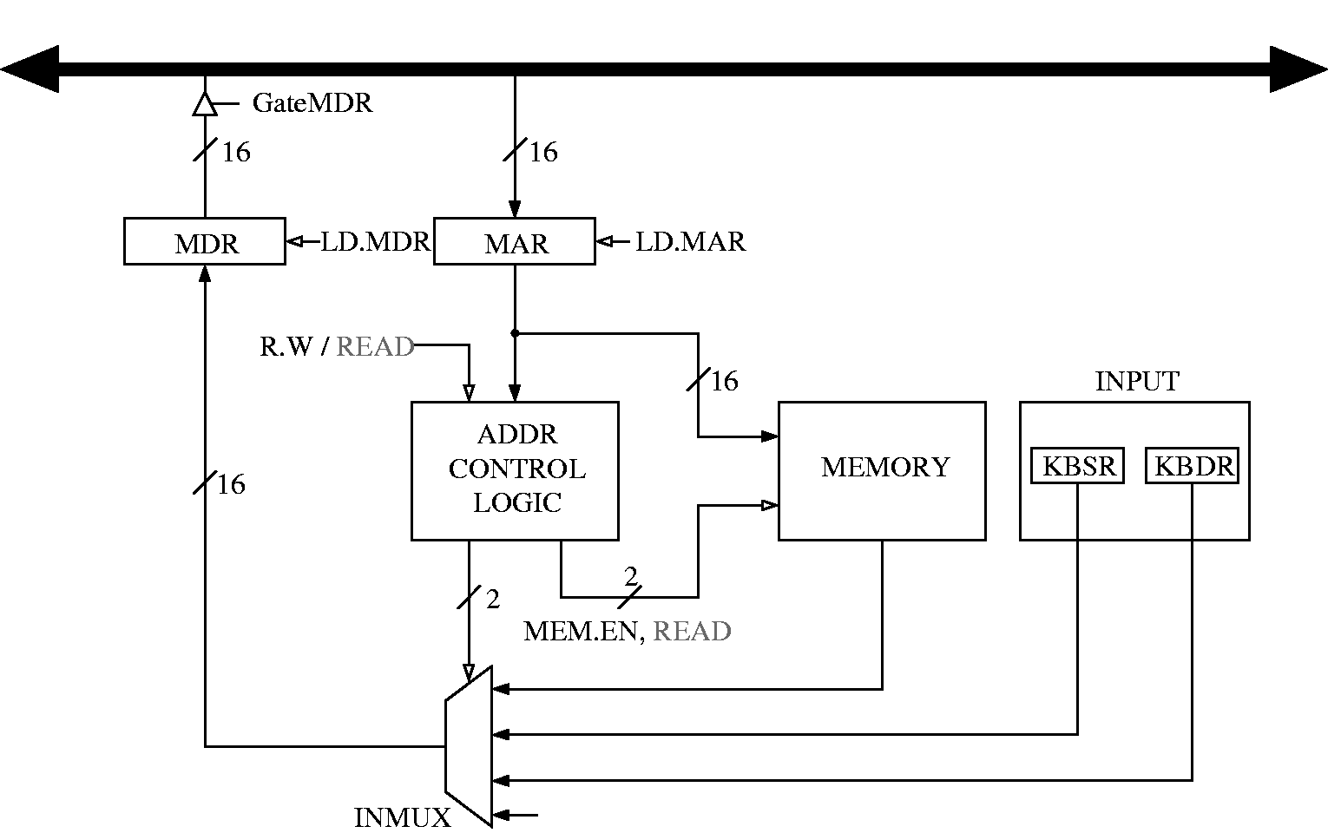
Simple Implementation: Memory-Mapped Input
Address Control Logic
determines whether
MDR is loaded from
Memory or from KBSR/KBDR.

Slide 13
Output to Monitor
When Monitor is ready to display another character:
  the “ready bit” (DSR[15]) is set to one
When data is written to Display Data Register:
  DSR[15] is set to zero
  character in DDR[7:0] is displayed
  any other character data written to DDR is ignored
  (while DSR[15] is zero)
output data
15
8
7
0
DDR
15
14
0
ready bit
DSR

Slide 14
Basic Output Routine
POLL LDI R1, DSRPtr
BRzp POLL
STI R0, DDRPtr
...
DSRPtr .FILL xFE04
DDRPtr .FILL xFE06
screen
ready?
NO
Polling
YES
write
character

Slide 15
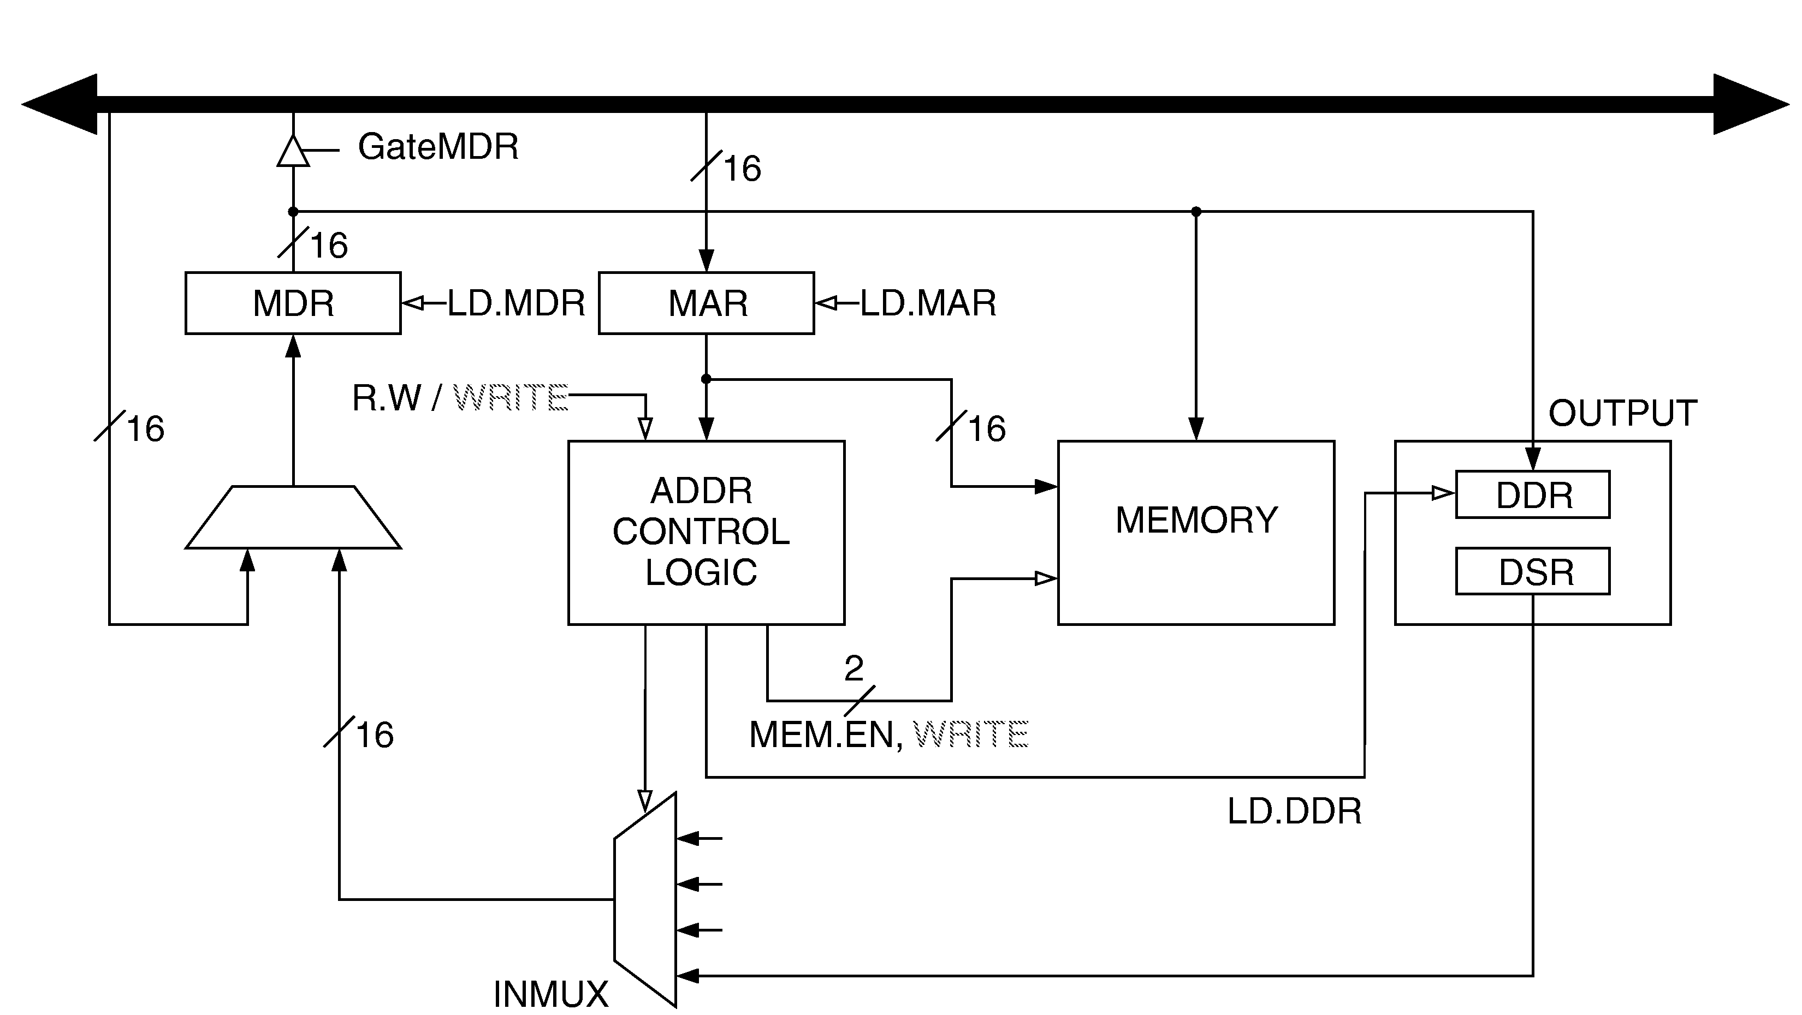
Simple Implementation: Memory-Mapped Output
Sets LD.DDR
or selects
DSR as input.

Slide 16
Keyboard Echo Routine
Usually, input character is also printed to screen.
  User gets feedback on character typed
  and knows its ok to type the next character.
POLL1 LDI R0, KBSRPtr
BRzp POLL1
LDI R0, KBDRPtr
POLL2 LDI R1, DSRPtr
BRzp POLL2
STI R0, DDRPtr
...
KBSRPtr .FILL xFE00
KBDRPtr .FILL xFE02
DSRPtr .FILL xFE04
DDRPtr .FILL xFE06
new
char?
NO
YES
read
character
screen
ready?
NO
YES
write
character

Slide 17
Interrupt-Driven I/O
External device can:
Force currently executing program to stop;
Have the processor satisfy the device’s needs; and
Resume the stopped program as if nothing happened.
Why?
  Polling consumes a lot of cycles,
  especially for rare events – these cycles can be used
  for more computation.
  Example: Process previous input while collecting
  current input. (See Example 8.1 in text.)

Slide 18
Interrupt-Driven I/O
To implement an interrupt mechanism, we need:
  A way for the I/O device to signal the CPU that an
  interesting event has occurred.
  A way for the CPU to test whether the interrupt signal is set
  and whether its priority is higher than the current program.
Generating Signal
  Software sets "interrupt enable" bit in device register.
  When ready bit is set and IE bit is set, interrupt is signaled.
interrupt enable bit
15
0
14
13
ready bit
KBSR
interrupt signal
to processor

Slide 19
Priority
Every instruction executes at a stated level of urgency.
LC-3: 8 priority levels (PL0-PL7)
  Example:
    Payroll program runs at PL0.
    Nuclear power correction program runs at PL6.
  It’s OK for PL6 device to interrupt PL0 program,
  but not the other way around.
Priority encoder selects highest-priority device,
compares to current processor priority level,
and generates interrupt signal if appropriate.

Slide 20
Testing for Interrupt Signal
CPU looks at signal between STORE and FETCH phases.
If not set, continues with next instruction.
If set, transfers control to interrupt service routine.
F
NO
D
interrupt
signal?
Transfer to
ISR
YES
EA
OP
EX
More details in Chapter 10.
S

Slide 21
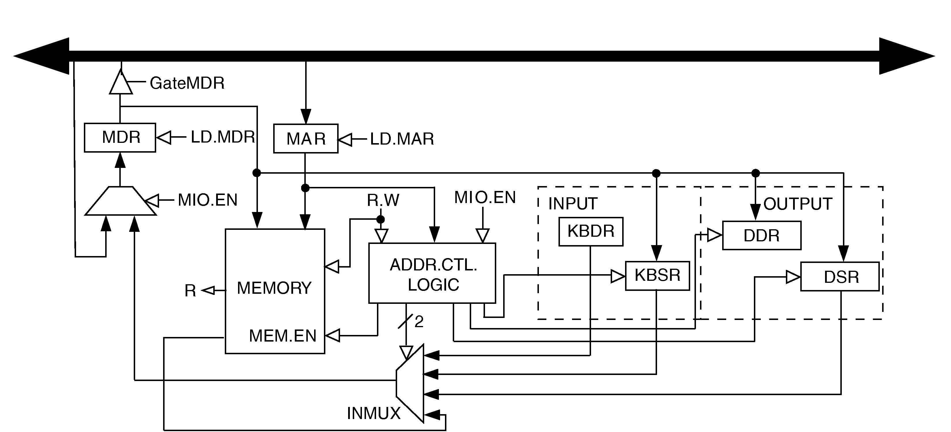
Full Implementation of LC-3 Memory-Mapped I/O
Because of interrupt enable bits, status registers (KBSR/DSR)
must be written, as well as read.

Slide 22
Review Questions
What is the danger of not testing the DSR
before writing data to the screen?
What is the danger of not testing the KBSR
before reading data from the keyboard?
What if the Monitor were a synchronous device,
e.g., we know that it will be ready 1 microsecond after
character is written.
  Can we avoid polling? How?
  What are advantages and disadvantages?

Slide 23
Review Questions
Do you think polling is a good approach for other devices,
such as a disk or a network interface?
What is the advantage of using LDI/STI for accessing
device registers?

